Slide 1
APON-WELLBEING SURVEY DATA ANALYSIS
CREATED BY:
MANISHA KARIM
https://colab.research.google.com/drive/1uXzb3j0nBjqHHnP-I0gweIGoURgXBv1I?usp=sharing

Slide 2
CONTENTS
SURVEYEE INFO
KNOWLEDGE ABOUT APON
CUSTOMER INFO
SHOPPING REASON
CUSTOMER KNOWLEDGE
PRODUCT LIST
REASON FOR NOT SHOPPING FROM APON
WHERE DO YOU SHOP FROM

Slide 3
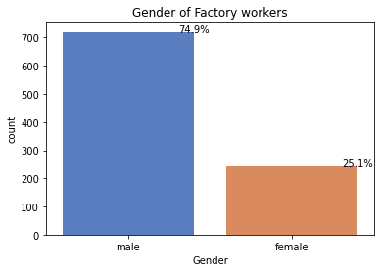
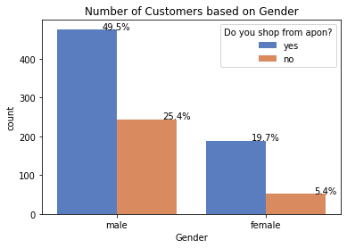
S U R V E Y E E I N F O

Slide 4
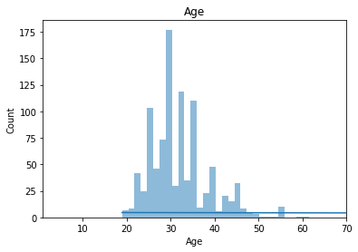
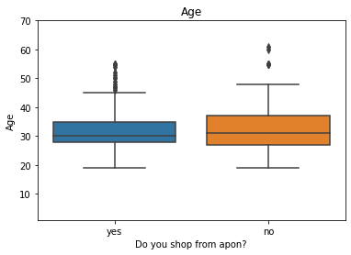
S U R V E Y E E I N F O

Slide 5
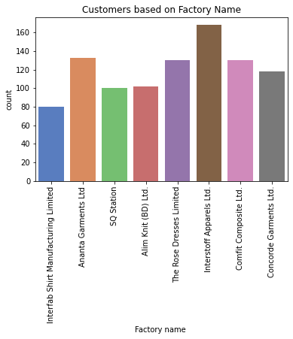
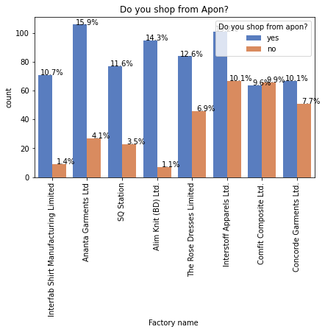
S U R V E Y E E I N F O

Slide 6
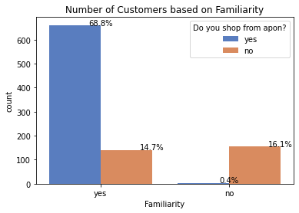
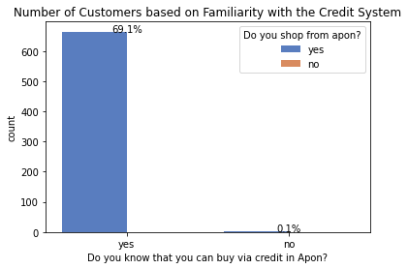
K N O W L E D G E
A B O U T A P O N

Slide 7
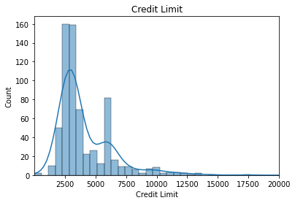
C U S T O M E R I N F O

Slide 8
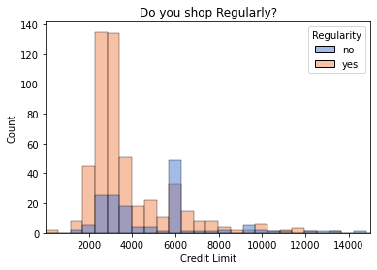
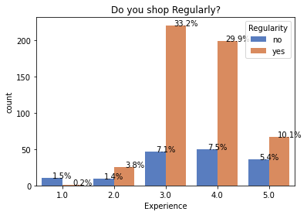
C U S T O M E R I N F O

Slide 9
S H O P P I N G
R E A S O N
Low Product Prices
Chance of Getting Insurance
Buying Products on Credit
Time Saving
Good Quality
Good Behaviour
Easy Transportation(Factory Shop)
34.96
20.55
15.7
13.4
10.35
3
1

Slide 10
C U S T O M E R
K N O W L E D G E
22.8
Discount Shop
17
Shop within the Factory
23.37
Can get discount if shop from here
Daily Necessities Shop
20
15
Can buy products on Loan

Slide 11
P R O D U C T S A L E S

Slide 12
R E A S O N S F O R N O T
S H O P P I N G
34%
8%
LOW INVENTORY
LOW CREDIT LIMIT
19%
4%
FAR FROM HOME
KNOWN SHOP
17%
2%
OTHERS
NOT FAMILIAR
13%
EXPENSIVE

Slide 13
W H E R E D O Y O U
S H O P F R O M ?
34%
3%
KNOWN SHOP
SHOPS NEXT TO FACTORY
20%
3%
LOAN SHOP
I DON’T SHOP
19%
2%
DISCOUNT SHOP
SOMEONE ELSE SHOPS
14%
2%
OTHERS
NO NEED TO SHOP

Slide 14
T H A N K Y O U

